Slide 1
Strings

Slide 2
Outline
Strings
Representation in C String Literals String Variables String Input/Output
printf, scanf, gets, puts String Manipulations String Functions
strlen, strcpy, strncpy, strcmp, strncmp, strcat, strncat, strchr, strrchr, strstr, strspn, strcspn, strtok

Slide 3
Strings
A WORD is a sequence of letters treated as a group (must of a meaning)
Months name: January, February …..
Course Titles: Math, Physics ….
Person’s name: Mr. Ali, Mr. Abbas, Mr. Takiona Nishiziki….
A string is a sequence of characters treated as a group (strings may not be meaningful)

Slide 4
Outline
Strings
Representation in C String Literals String Variables String Input/Output
printf, scanf, gets, puts String Manipulations String Functions
strlen, strcpy, strncpy, strcmp, strncmp, strcat, strncat, strchr, strrchr, strstr, strspn, strcspn, strtok

Slide 5

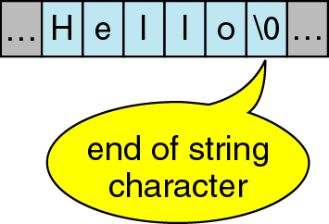
Strings in C
No explicit type, instead strings are maintained as arrays of characters
Representing strings in C
stored in arrays of characters
array can be of any length
end of string is indicated by a delimiter, the zero character '\0'

Slide 6
Outline
Strings
Representation in C String Literals String Variables String Input/Output
printf, scanf, gets, puts String Manipulations String Functions
strlen, strcpy, strncpy, strcmp, strncmp, strcat, strncat, strchr, strrchr, strstr, strspn, strcspn, strtok

Slide 7
String Literals
String literal values are represented by sequences of characters between double quotes )
Examples
"hello"
"" - empty string
"H" versus 'H'
'H' is a single character value (stored in 1 byte) as the ASCII value for H (72)
"H" is an array with two characters, the first is H, the second is the character value \0

Slide 8
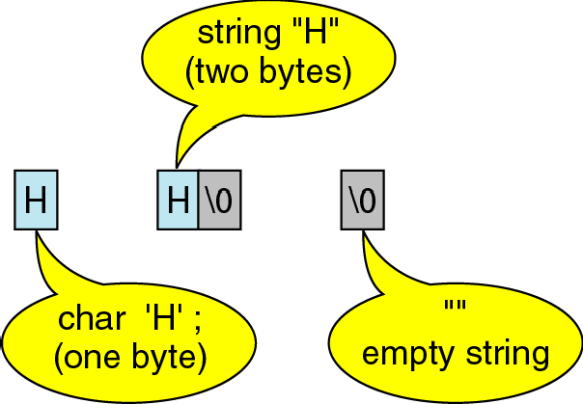
String Literals

Slide 9
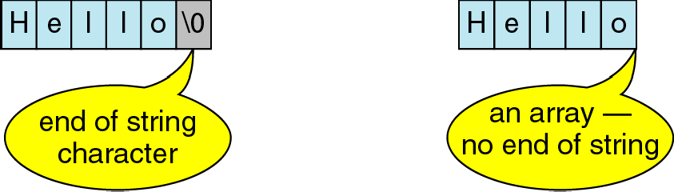
String Literals

Slide 10
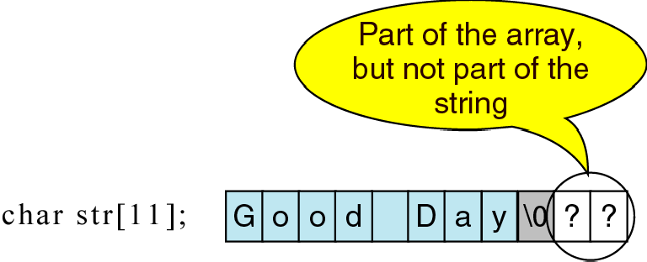
String Literals

Slide 11
Outline
Strings
Representation in C String Literals String Variables String Input/Output
printf, scanf, gets, puts String Manipulations String Functions
strlen, strcpy, strncpy, strcmp, strncmp, strcat, strncat, strchr, strrchr, strstr, strspn, strcspn, strtok

Slide 12
String Variables
Allocate an array of a size large enough to hold the string (plus 1 extra value for the delimiter)
Examples (with initialization):
char str1[6] = "Hello"; char str2[ ] = "Hello"; char str3[20] = "Hello";
char str5[6] = {'H','e','l','l','o','\0'};
Note, each variable is considered a constant in that the space it is connected to cannot be changed
str1 = str2; /* not allowed, but we can copy the contents of str2 to str1 (more later) */

Slide 13
Changing content of String Variables
Can change parts of a string variable
char str1[6] = "hello"; str1[0] = 'y';
/* str1 is now "yello" */ str1[4] = '\0';
/* str1 is now "yell" */
Important to retain delimiter (replacing str1[5] in the original string with something other than '\0' makes a string that does not end)
Have to stay within limits of array

Slide 14
Duplicate String Literals
Each string literal in a C program is stored at a different location
So even if the string literals contain the same string, they are not equal (in the == sense)
Example:
char str1[6] = "hello";
char str2[6] = "hello";
but str1 does not equal str2 (they are stored at different locations)
if(str1 == str2) … is FALSE

Slide 15
Outline
Strings
Representation in C String Literals String Variables String Input/Output
printf, scanf, gets, puts String Manipulations String Functions
strlen, strcpy, strncpy, strcmp, strncmp, strcat, strncat, strchr, strrchr, strstr, strspn, strcspn, strtok

Slide 16
String Input
Use %s field specification in scanf to read string
ignores leading white space
reads characters until next white space encountered
C stores null (\0) char after last non-white space char
Reads into array (no & before name, array is a pointer)
Example:
char Name[11]; scanf("%s", Name);

Slide 17
Input a String
gets
Get a string from user input
reads until enter is pressed
main(){
char c[80]; gets(c); printf("%s\n", c);
}
Input: TODAY IS MONDAY Output: TODAY IS MONDAY

Slide 18
String Output
Use %s field specification in printf:
characters in string printed until \0 encountered char Name[10] = "Rich";
printf("%s",Name); /* outputs Rich */

Slide 19
Outline
Strings
Representation in C String Literals String Variables String Input/Output
printf, scanf, gets, puts String Manipulations String Functions
strlen, strcpy, strncpy, strcmp, strncmp, strcat, strncat, strchr, strrchr, strstr, strspn, strcspn, strtok

Slide 20
Determining length of a string
strlen
Returns the number of characters in "Saturday"
int length = strlen("Saturday");
//answer is 8

Slide 21
Write down a program that will print n-th letter in a sentence entered by a user. n will be input to your program

Slide 22

Hello
e
Your Program
1
0 1 2 3 4 5
Position: 1

Slide 23
Solution
main()
{
char s[80]; int n, length;
printf("Enter a Sentence:"); gets(s);
length = strlen(s);
printf("Total char in sentence is:%d\n", length);
printf("Which position?"); scanf("%d",&n);
if(n < length)
printf("The letter is:
else
%c", s[n]);
printf("No letter at such position");
}

Slide 24
Write down a program that will print letters of a sentence in a vertical line.
Add delay as needed.

Slide 25
HELLO
H E
Your Program
L L O

Slide 26
Solution
#include <windows.h> main()
{
char s[80];
int n,length,i; printf("Enter a Sentence:"); gets(s);
length = strlen(s);
for(i = 0; i < length; i++)
{
printf("%c\n",s[i]); Sleep(500);
}
}

Slide 27
Write down a program that searches for a letter in a sentence. Both letter and sentence will be input to your program. Print last position of the letter found in the sentence.

Slide 28
Hello
1
Your Program
e
0 1 2 3 4 5
Position: 1

Slide 29
Solution
main()
{
char s[80],t;
int n,l,i,p;
printf("Enter a Sentence:"); gets(s);
printf("Which letter? "); scanf("%c",&t);
length = strlen(s); p = -1;
for(i = 0; i < length; i++) if(s[i] == t)
p = i;
if(p == -1) printf("Sorry not found"); else printf("Found at position: %d", p);
}

Slide 30
0 1 2 3 4 5
l
Position: 2
Position: 3

Slide 31
Write down a program that prints how many times a letter appeared in a sentence. Both letter and
sentence will be input to your program.

Slide 32
Solution
main()
{
char s[80],t; int n,l,i,count;
printf("Enter a Sentence:"); gets(s);
printf("Which letter? "); scanf("%c",&t);
length = strlen(s); count = 0;
for(i = 0; i < length; i++) if(s[i] == t)
count++;
if(count == 0) printf("Sorry not found"); else printf("Found %d times", count);
}

Slide 33
Write down a program that prints how many words, letters, vowels and consonants exist in a
sentence. The sentence will be input to your program.

Slide 34
Solution
main(){
char s[80],t;
int w, v, c, l, i,length; printf("Enter a Sentence:"); gets(s);
length = strlen(s); w = v = c = 0;
for(i = 0; i < length; i++){ t = tolower(s[i]);
if(t == ' ') w++;
else if ((t == 'a') || (t == 'e') || (t == 'i') || (t == 'o') || (t == 'u'))
v++;
else c++;
}
printf("Number of words: %d \n",w+1); printf("Number of letters: %d \n",v+c); printf("Number of vowels: %d \n",v); printf("Number of consonants: %d \n",c);
}

Slide 35
Example:
char str1[6] = "hello";
char str2[6] = "hello";
if(str1 == str2) … does not evaluate to be TRUE
Write down a function that compares two strings and returns 1 if they are same and returns 0 otherwise

Slide 36
Solution
int samestring(char s1[ ], char s2[ ]) { int i,c=0;
/* Not same if not of same length */ if (strlen(s1) != strlen(s2))
return 0;
/* look at each character in turn */ for (i = 0; i < strlen(s1); i++)
/* if a character differs, string not same */ if (s1[i] == s2[i]) c++;
if(c == strlen(s1)) return 1; else return 0;
}

Slide 37
Write down a program that will take a word as input and will determine whether the word is palindrome or not. A
palindrome is a word that reads the same backward as forward
mom dad eye level madam

Slide 38
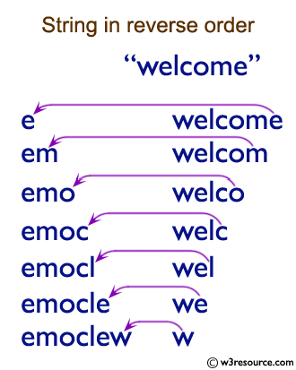
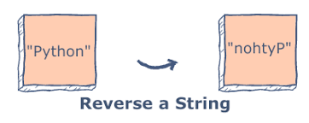

Slide 39
Solution
main(){
char s[80],t[80];
int length, i, j,c = 0; gets(s);
length = strlen(s); j = 0;
for(i = length-1; i >= 0; i--){ t[j] = s[i];
j++;
}
for(i = 0; i < length; i++){ if(s[i] == t[i]){
c++;
}
}
if(c == length) printf("Palindrome");
else
printf("No");
}

Slide 40
Solution (in-place check i.e. without using any extra array)
main(){
char s[80];
int length, i, j,c = 0; gets(s);
length = strlen(s); j = length-1;
for(i = 0; i < j; i++,j--){
if(s[i] == s[j]){ c++;
}
}
if(c == length/2) printf("Palindrome");
else
printf("No");
}

Slide 41
Outline
Strings
Representation in C String Literals String Variables String Input/Output
printf, scanf, gets, puts String Manipulations String Library Functions
strlen, strcpy, strncpy, strcmp, strncmp, strcat, strncat, strchr, strrchr, strstr, strspn, strcspn, strtok

Slide 42
Strings input output
gets(s) – take a string as input and place it in array s
puts(s) – show the content of the string s
#include <stdio.h> #include <string.h> int main() {
char s[30];
printf("Please enter a sentence: "); gets(s);
puts("You have entered: "); puts(s);
return 0;
}

Slide 43
Strings initialization at the time of declartion
#include <stdio.h> #include <string.h> int main() {
char s[80]="To be or not to be that is the question"; puts(s);
return 0;
}

Slide 44
C offers following major library functions on strings
strlen(s) – return the length of a string s
strlwr(s)– convert the string s in lower case
strupr(s) – convert the string s in upper case
strrev(s) – reverse the content of the string s
strcpy(s, t) – copy string t into another string s
strncpy(s, t, n) - copy n characters of string t into another string s
strcat(s, t) – append string t into the right side of the string s
strncat(s, t, n) - append n characters of the string t onto the right side of the string s
strcmp(s, t) – compare alphabetic order of two strings s and t

Slide 45


For detailed implementation see:
https://en.wikibooks.org/wiki/C_Programming
/String_manipulation

Slide 46
strlen(s) – returns the length of a string s

Slide 47
Example
#include <stdio.h> #include <string.h> int main( ) {
char str[20] = "BeginnersBook"; int length;
length = strlen(str);
printf("Length of the string is : %d", length); return 0;
}
Output:
Length of the string is: 13

Slide 48
strlwr(s)– convert the string s in lower case

Slide 49
Example
#include <stdio.h> #include <string.h> int main( ) {
char str[20] = "BeginnersBook"; strlwr(str);
printf("%s",str); return 0;
}
Output:
beginnersbook

Slide 50
strupr(s)– convert the string s in upper case

Slide 51
Example
#include <stdio.h> #include <string.h> int main( ) {
char str[20] = "BeginnersBook"; strupr(str);
printf("%s",str); return 0;
}
Output:
BEGINNERSBOOK

Slide 52
strrev(s) – reverse the content of the string s

Slide 53
Example
#include <stdio.h> #include <string.h> int main( ) {
char str[20] = "DRAWER"; strrev(str); printf("%s",str);
return 0;
}
Output:
REWARD

Slide 54
strcpy(s, t) – copy string t into another string s

Slide 55
Example
#include <stdio.h> #include <string.h> int main() {
char s1[30] = "Bad"; char s2[30] = "Good"; strcpy(s1, s2); printf("%s",s1);
return 0;
}
Output:
Good

Slide 56
Example
#include <stdio.h> #include <string.h> int main() {
char s1[30] = "Bad"; char s2[30] = "Good"; strcpy(s2, s1); printf("%s",s2); return 0;
}
Output:
Bad

Slide 57


strncpy(s, t, n) -
copy n characters of
string t into another string s. Fills with null character if t doesn’t have n characters

Slide 58
Example
#include <stdio.h> #include <string.h> int main() {
char s1[30] = "Coastal"; char s2[30] = "Cry"; strncpy(s1, s2,3); printf("%s",s1);
return 0;
}
Output:
Crystal

Slide 59
Example
#include <stdio.h> #include <string.h> int main() {
char s1[30] = "Coastal"; char s2[30] = "Cry"; strncpy(s1, s2,4); printf("%s",s1);
return 0;
}
Output:
Cry

Slide 60

strcat(s, t) – append string t into the right side of the string s

Slide 61
Example
#include <stdio.h> #include <string.h> int main() {
char s1[30] = "Hello "; char s2[30] = "World"; strcat(s1, s2); printf("%s",s1);
return 0;
}
Output:
Hello World

Slide 62

strncat(s, t, n) - append n characters of the string t onto the right side of the string s. Always add NULL character at the end

Slide 63
Example
#include <stdio.h> #include <string.h> int main() {
char s1[30] = "";
char s2[30] ="Happy "; strncat(s1, s2, 6); printf("%s",s1);
return 0;
}
Output:
Happy

Slide 64
LITTLE QUIZ FOR YOU

Slide 65
Example
#include <stdio.h> #include <string.h> int main() {
char s1[30] = "Happy "; char s2[30] = "New Year!"; char s3[30];
strcat(s1, s2); strcpy(s3, ""); strncat(s3, s1,6); strcat(s3, s1); printf("%s",s3); return 0;
s1 = "Happy New Year!"
s3 = ""
s3 = "Happy "
s3 = "Happy Happy New Year!"
}
Output:
Happy Happy New Year!

Slide 66
strcmp(s, t) – compare alphabetic order of two strings s and t

Slide 67
strcmp
strcmp(s, t)
Compares s and t alphabetically
Returns a negative value if s precedes t alphabetically
Returns a positive value if t precedes s alphabetically
Returns 0 if they are same
Note lowercase characters are greater than Uppercase

Slide 68
strcmp example
strcmp(s, t)
s1 | s2 | return value | reason
“AAAA” | “ABCD” | < 0 | ‘A’ <‘B’
“B123” | “A089” | > 0 | ‘B’ > ‘A’
“127” | “409” | < 0 | ‘1’ < ‘4’
“abc888” | “abc888” | = 0 | equal string
“abc” | “abcde” | < 0 | s1 is a sub string of s2

Slide 69
Example
#include <stdio.h> #include <string.h> int main() {
char s1[ ] = "cat";
char s2[] = "cat";
char s3[] = "dog";
int x = strcmp(s1, s2); if(x == 0)
printf("They are same") ; else if (x < 0)
printf("s1 comes before s2") ; else if (x > 0)
printf("s1 comes after s2") ; return 0;
}
Output:
They are same

Slide 70
Example
#include <stdio.h> #include <string.h> int main() {
char s1[ ] = "cat";
char s2[] = "cat";
char s3[] = "dog";
int x = strcmp(s1, s3); if(x == 0)
printf("They are same") ; else if (x < 0)
printf("s1 comes before s3") ; else if (x > 0)
printf("s1 comes after s3") ; return 0;
}
Output:
s1 comes before s3

Slide 71
strcmpi(s, t) – compare alphabetic order of two strings s and t ignoring case

Slide 72
Example
#include <stdio.h> #include <string.h> int main() {
char s1[ ] = "cat";
char s2[] = “Cat";
char s3[] = "dog";
int x = strcmp(s1, s2) ; if(x == 0)
printf("They are same") ; else if (x< 0)
printf("s1 comes before s2") ; else if (x > 0)
printf("s1 comes after s2") ; return 0;
}
Output:
s1 comes after s2

Slide 73
Example
#include <stdio.h> #include <string.h> int main() {
char s1[ ] = "cat";
char s2[] = “Cat";
char s3[] = "dog";
int x = strcmpi(s1, s2); if(x == 0)
printf("They are same") ; else if (x < 0)
printf("s1 comes before s2") ; else if (x > 0)
printf("s1 comes after s2") ; return 0;
}
Output:
They are same

Slide 74
Program: Palindrome testing

Slide 75
Example: Palindrome testing
#include <stdio.h> #include <string.h> int main() {
char s[80]="madam"; char t[80];
gets(s);
strcpy(t,s); strrev(t); if(strcmpi(s,t) == 0)
printf("\"%s\" is a palindrom", s);
else
printf("\"%s\" is NOT a palindrom", s); return 0;
}

Slide 76
Write down a program that searches for a word in a sentence. Both word and sentence will be input to your program. Print first position of the word found in the sentence.

Slide 77
Solution
main()
{ char s[80],t[80]; int i,p;
printf("Enter a Sentence:"); gets(s);
printf("Which word? "); gets(t);
p = -1;
for(i = 0; i < strlen(s); i++) if(s[i] == t[0]){
for(j = 1; j < strlen(t); j++) if(s[i+j] != t[j])
break; if(j == strlen(t)){
p = i; break;
}
}
if(p == -1) printf("Sorry not found"); else printf("Found at position: %d", p);
}

